Slide 1
Git Basics
A BPI Training Program

Slide 2
Git Basics
What is Git
It is a distributed Version Control System used for tracking file changes and allowing for collaboration between different developers.
It allows developers to have their own copy of the repository including the change history of the project.
Branching allows developers to create another copy of the code (at a certain point) and develop new features on that branch until it merges back to the master branch.

Slide 3
Git Basics
I want to create a repository
To create a repository, go to github.com, sign in, and look for buttons labelled “new” and create a new repository
Provide a repository name, set it to public, add .gitignore (Java)

Slide 4
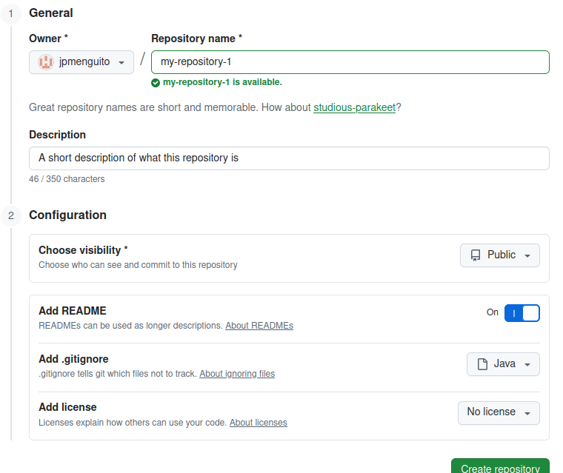
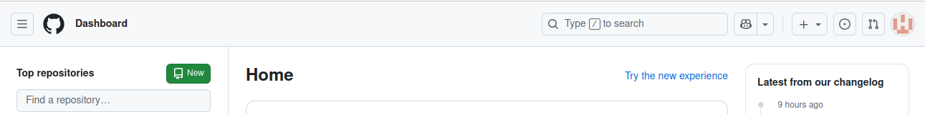
Git Basics
I want to create a repository

Slide 5
Git Basics
2. I want to clone a repository
Navigate to your repository via github.com and selecting the repository name from your list of repositories.
Once you’re in the repository, look for a green button “Code” and copy the HTTP Address you’ll see. It should end with “.git”
Once copied, on your Desktop Computer, open a Command Prompt / Power Shell / Terminal in a folder of your choice and then type the command:
git clone <the copied https>
Upon cloning, use the command “cd <folder name of the cloned repository>” to let your terminal go into that folder.
*Note: It may ask you to sign in / provide a token

Slide 6
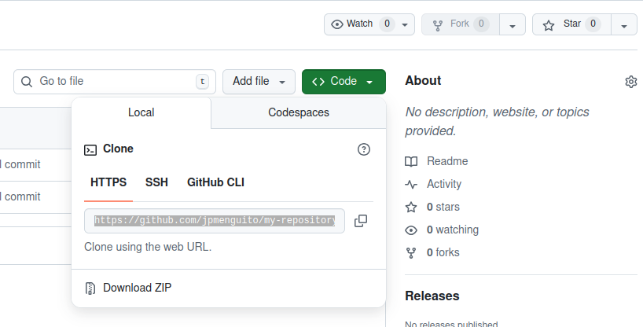
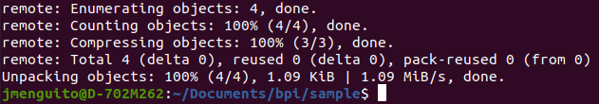
Git Basics
2. I want to clone a repository

Slide 7
Git Basics
3. I need to create a branch
Create and Switch to a branch:
git switch -c <branch_name_i_want_to_create>
Switch to an existing branch:
git switch <my_existing_branch>
Create a branch only:
git branch <branch_name_i_want_you_create>
Display all existing local branches:
git branch

Slide 8

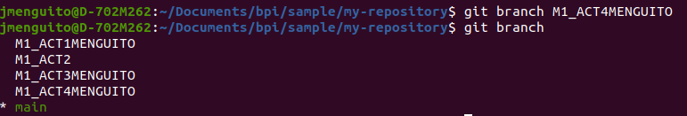
Git Basics
3. I need to create a branch

Slide 9
Git Basics
4. I need to switch to a branch
Switch to an existing branch:
git switch <my_existing_branch>
or
git checkout <my_existing_branch>

Slide 10

Git Basics
4. I need to switch to a branch

Slide 11
Git Basics
5. I want to add/change a file and push it
Add/Change the files you need
optional: git switch <your_branch_of_choice>
git add .
git commit -m “<Enter a short description on what you changed>”
git push origin <your_branch_of_choice>

Slide 12
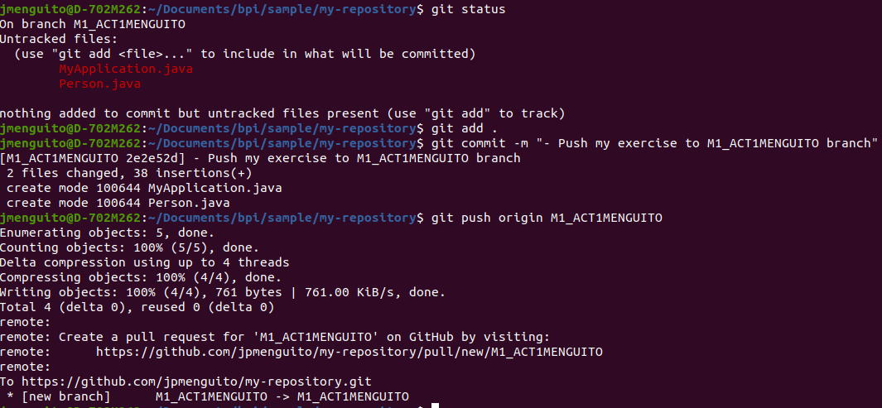
Git Basics
5. I want to add/change a file and push it

Slide 13
Git Basics
6. I need to pull my code
To pull a code from the remote to your local
(also known as pulling/merging)
git pull origin <the_remote_branch_you_want_to_pull_from>

Slide 14
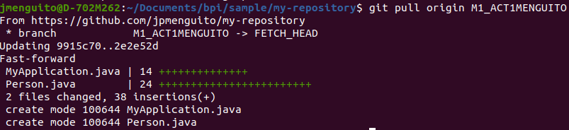
Git Basics
6. I need to pull my code

Slide 15
Git Basics
Summary
add/change file and push:
> git add .
> git commit -m “Commit message”
> git push origin main
create a branch:
> git branch <branch_name>
display branches:
> git branch
switch to an existing branch:
> git checkout <branch_name>
create and switch in one command:
> git switch -c <branch_name>
pull/merge/sync changes
> git pull origin main
check status of current git repo / check what actions you can do
> git status

Slide 16
Git Basics
Glossary
Branch: A snapshot / copy of a specific state of your repository separate from other branches
Commit: A specific point in time marking a specific set of changes
Local (Repository): Your local copy of the repository
Pull: To merge the online repository into your local
Push: To Upload your files to the remote repository
Remote (Repository): The copy of the repository online and visible to other developers.
Repository: Your codebase / code directory / project / folder

